Slide 1
Statistical Genomics and Bioinformatics Workshop 2025
Neurogenomics Program, CGPH
Mr Paul Ruiz Pinto, Dr Heidi Sutherland and Prof Divya Mehta

Slide 2
Outline
About this workshop
What will be taught – GWAS (Part 1) and DNAm (Part 2)
Housekeeping - breaks and lunch break

Slide 3
Genome-wide association studies

Slide 4
Some biology
Traits (includes characteristics as well as disorders) – monogenic or polygenic (mono: one, poly: many, genic: gene)
Polygenic trait: When a trait or characteristic is influenced by two or more genes or genetic variants.
Examples of polygenic traits include height, skin colour, hair colour
Polygenic traits can be complex or multifactorial when caused by multiple genes as well as by environmental and lifestyle factors
Examples include asthma, type-3 diabetes, PTSD, depression, cancer, metabolic syndrome

Slide 5
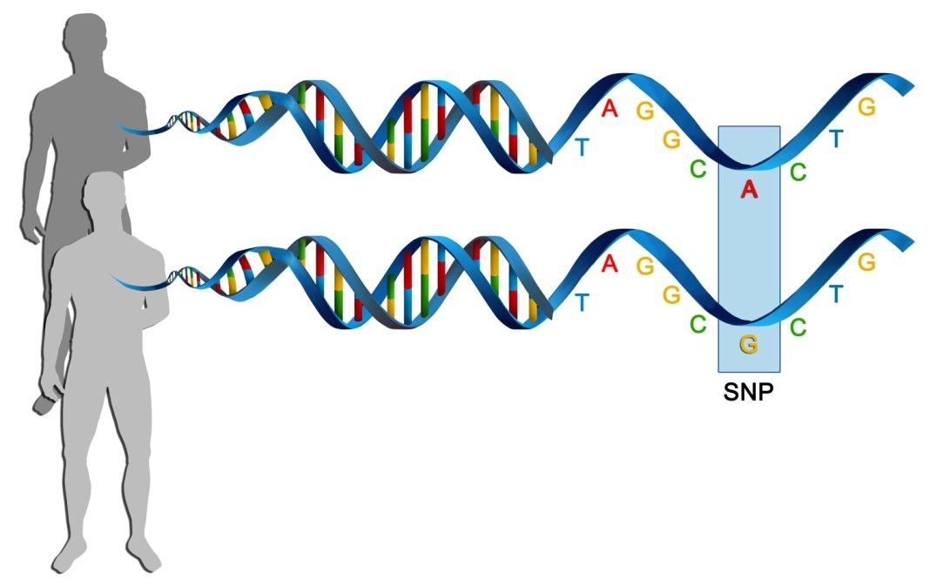
Some biology
Genetic variants: Also known as single nucleotide polymorphisms (SNPs) is a single base-pair at which more than one nucleotide is observed (poly: many, morphe: form)
Example: Position 100 on chromosome 1 has nucleotide A in majority of the people in a population but some have nucleotide G in the same position, then this position is called a SNP with alleles G and A
Allele frequency: Indicates how common an allele is in a population. Calculated by counting the number of times we see an allele in a population and divided by the total number of copies of a gene
Minor allele frequency (MAF): The frequency of the second most common allele in a population (minor allele)
Common SNPs: SNPs with MAF > 0.05 or > 0.01
Image source: https://www.genengnews.com/topics/omics/study-finds-genetic-basis-of-common-diseases-may-span-tens-of-thousands-of-snps/

Slide 6
What is GWAS and why do it?
Genome-wide Association Study (GWAS): Hypothesis free univariate association analysis of hundreds of thousands to millions of common genetic variants (MAF ≥ 0.01 or 0.05) across the genomes of many individuals to identify genotype–phenotype associations
Phenotypes in GWAS are complex traits or diseases
First GWAS was conducted in 2005 for age-related macular degeneration [Klein et al, 2005]. Since then >3,500 published GWASs for a wide variety of traits and disorders have been conducted
Why do it?
Identification of novel disease-causing genes and mechanisms
Insights in genetic architecture of the trait
Identification of new drug targets and disease biomarkers
Risk prediction
Optimisation of therapies based on genotype
Klein RJ, Zeiss C, Chew EY, et al. Complement factor H polymorphism in age-related macular degeneration. Science 2005;308:385–389

Slide 7
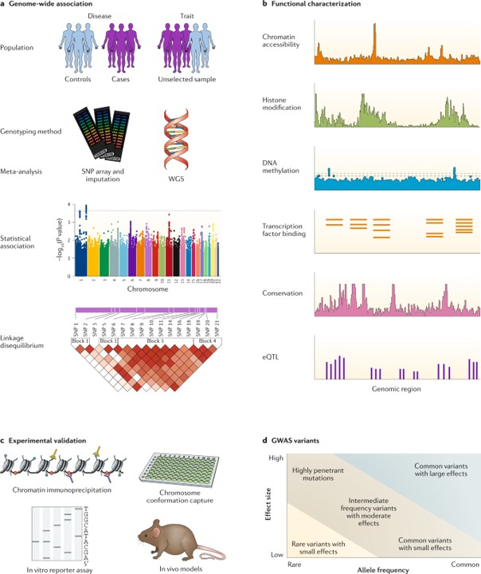
GWAS workflow

Slide 8
Step 1 - GWAS
Study design
Phenotype determination
Selecting an appropriate study population based on the phenotype – cases and controls or unselected population
Genotyping method
Whole genome sequencing
SNP array followed by imputation of remaining SNPs on genome using appropriate human reference genome
Meta-analysis: Combining the results from independent previous GWASs
Association analysis
Test for association of SNP with the phenotype
Linear regression for continuous phenotype or logistic regression for binary trait
Identify regions of interest
Regions that have reached genome-wide significance (association p < 5 × 10⁻⁸) or suggestive significance (association p < 1 × 10⁻⁵)
Account for linkage equilibrium
Note - linkage disequilibrium (LD) is the non-random association of alleles at different loci in a given population

Slide 9
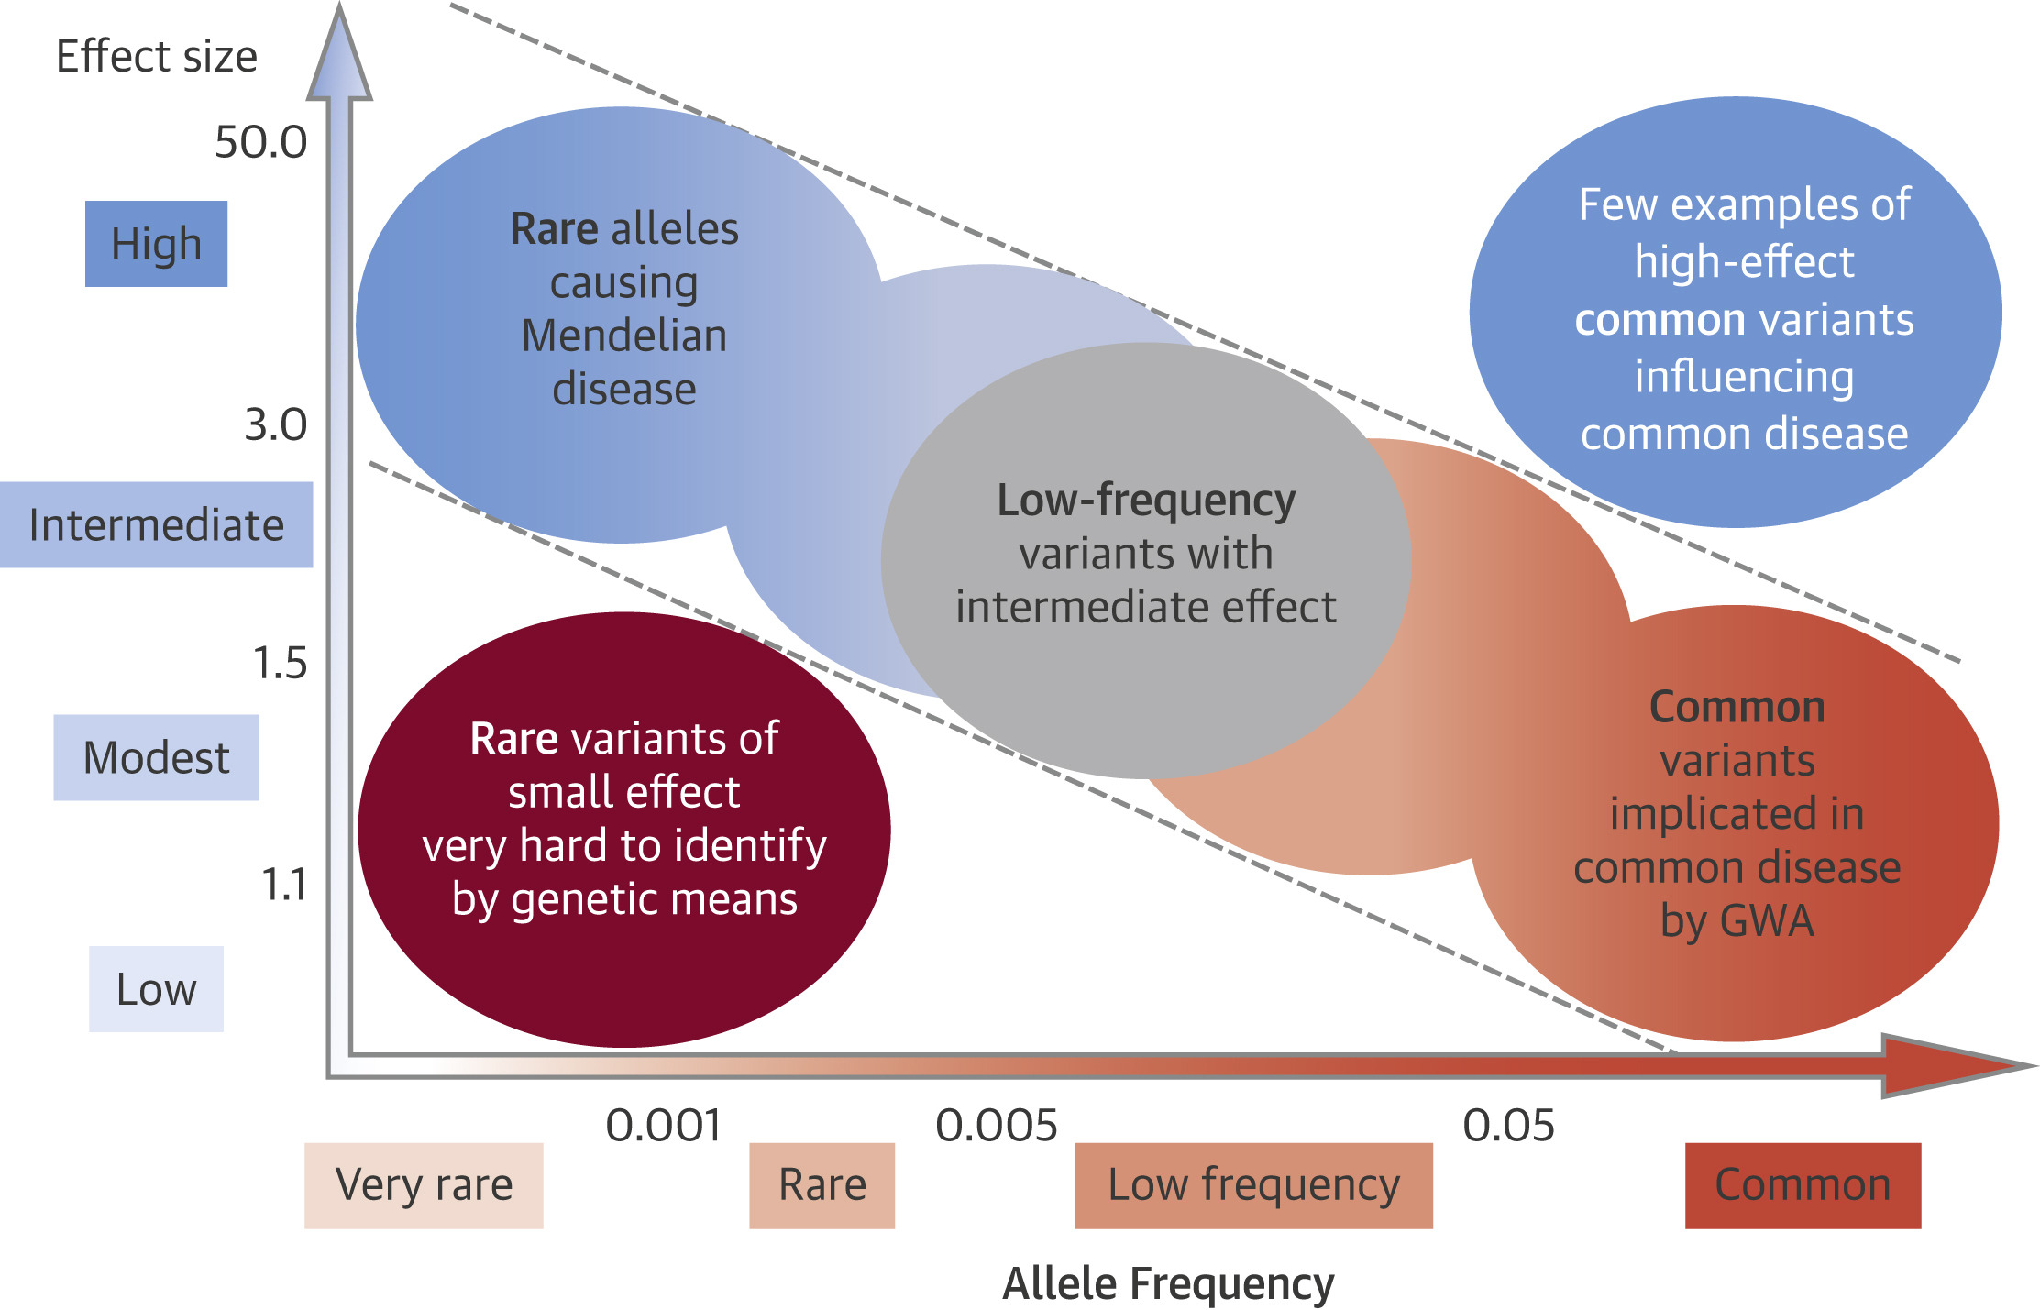
GWAS results
GWAS analyses common variants (MAF > 0.05)
The effect sizes of significant variants are < 1.5 (low to moderate)
An allelic effect size is the magnitude of the effect of an allele on a phenotype
Source: Assimes, Themistocles L., and Robert Roberts. "Genetics: implications for prevention and management of coronary artery disease." Journal of the American College of Cardiology 68.25 (2016): 2797-2818.

Slide 10
Step 2 – Functional characterisation (Post-GWAS analysis)
Includes a wide variety of computational/bioinformatic approaches
To understand the biological significance of the identified variants and prioritise variants and genes
Approaches:
Gene annotation of the SNPs
Pathway analysis
Fine-mapping to identify causal variants
Integrative analysis with other omics to identify the mechanistic role of the variants
Tissue enrichment
Cross-disorder or cross-phenotype analysis
Polygenic risk score analysis
Source: Tam, Vivian, et al. "Benefits and limitations of genome-wide association studies." Nature Reviews Genetics 20.8 (2019): 467-484.

Slide 11
Step 3 – Experimental validation
Validation of GWAS results using cell-based systems and model organisms
Source: Tam, Vivian, et al. "Benefits and limitations of genome-wide association studies." Nature Reviews Genetics 20.8 (2019): 467-484.

Slide 12
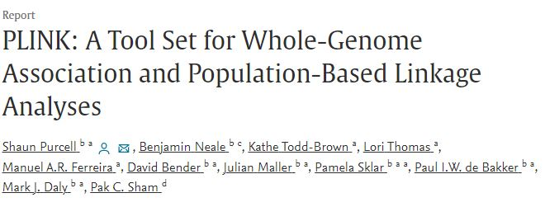
PLINK
An open-source software for whole genome data analysis
Command-line program
Performs
Data management
Summary statistics for quality control
Population stratification
Association testing
And many more…
https://zzz.bwh.harvard.edu/plink/

Slide 13
Genotype data
 | SNP1 | SNP2 | SNP3 | … | SNPn
Ind1 | TT | AG | CT | … | AT
Ind2 | TT | GG | CT | … | AA
Ind3 | AT | GG | TT | … | TT
… | … | … | … | … | …
Indn | AA | AA | TT | … | AT
Genotypes are stored in a matrix of size n × N with n >> N
In PLINK, the bed file stores the genotype matrix in the form of 0, 1 and 2 or NA
0, 1 and 2 indicate the number of copies of A1 allele.

Slide 14
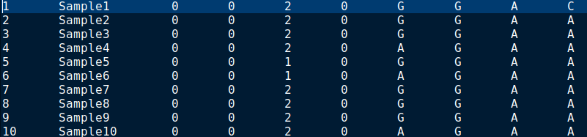
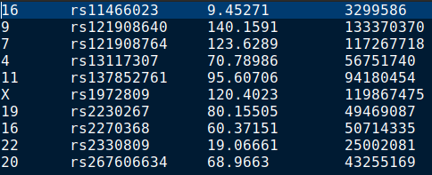
PLINK files – PED and MAP
PED file
PED file -
Family ID (FID)
Individual ID (IID)
Paternal ID
Maternal ID
Sex (1=male; 2=female)
Phenotype (quantitative trait or affection status)
Genotype information
MAP file -
Chromosome (1-22, X/23, Y/24, Mt/26)
rs# or SNP identifier
Genetic distance
Base-pair position (bp)
MAP file

Slide 15
PLINK files – Phenotype and covariates
If present phenotype file has information on the phenotype studied
2+ columns
Family ID
Individual ID
Phenotype 1
Phenotype 2
… Phenotype x
-9 or 0 is considered as missing
Case/Control as 1 = Control and 2 = Case
Covariates file have the sample format
These can include information such as Age, principal components, etc

Slide 16
PLINK files – the binary Ped files
PED and MAP are not efficient way to store data:
For 503 individuals with 22,665,064 variants: PED file 43G and MAP file is 542M
Efficient way to store whole genome data as using binary format of PED and MAP files
The are a set of 3 files
bed (binary genotype) (2.7G)
bim (binary mapping) (629M)
fam (family details) (13K)

Slide 17
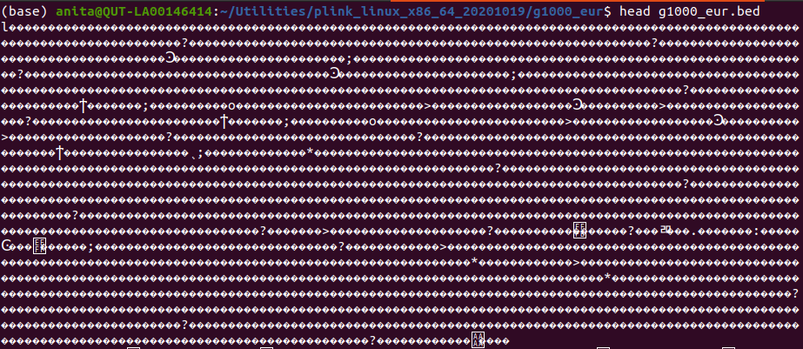
BED file
Binary format of genotype file
Genotypes are stored in a matrix of size n × N with n >> N
In PLINK, the bed file stores the genotype matrix in the form of 0, 1 and 2 or NA in binary format
0, 1 and 2 indicate the number of copies of A1 allele (default – minor allele).
 | SNP1 | SNP2 | SNP3 | … | SNPn
Ind1 | TT | AG | CT | … | AT
Ind2 | TT | GG | CT | … | AA
Ind3 | AT | GG | TT | … | TT
… | … | … | … | … | …
Indn | AA | AA | TT | … | AT
 | SNP1 | SNP2 | SNP3 | … | SNPn
Ind1 | 2 | 1 | 1 | … | 1
Ind2 | 2 | 0 | 1 | … | 2
Ind3 | 1 |  | 0 | … | 0
… | … | … | … | … | …
Indn | 0 | 2 | 0 | … | 1

Slide 18
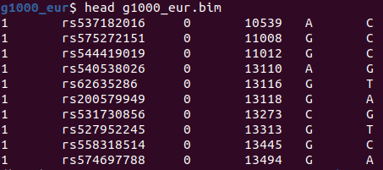
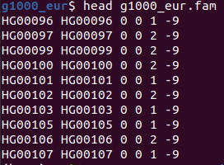
Binary mapping (bim) and Family (fam) files
The bim file contains information on the SNPs
Chromosome
Rs# or SNP identifier
Centimorgan
Base pair location
Minor allele in PLINK 1.9 (Alternate allele in PLINK 2)
Major allele in PLINK 1.9 (Reference allele in PLINK 2)
The fam file contains information on the individuals (first 6 columns of the PED file)
Family ID (FID)
Individual ID (IID)
Paternal ID
Maternal ID
Sex (1=male; 2=female)
Phenotype (quantitative trait or affection status)

Slide 19
Simple commands
Setting input
Note: All plink file (PED or binary have the same file name with different file extensions. E.g.: g1000_eur.bed, g1000_eur.bim, g1000_eur.fam
If input file is PED then: --file <filename (without extension)>
In input file is binary PED then: --bfile <filename (without extension)>
Setting output
--out <filename>
Convert PED to BED
plink --file g1000_eur --make-bed --out new_g1000
Here --make-bed if the flag to generate BED file
Getting help
plink --help

Slide 20
Simple commands – selecting samples
Selecting a set of samples for downstream analysis
plink --file g1000_eur --keep mysamples.txt --out new_g1000
--keep: Excludes all samples not named in the file
Removing a set of samples
plink --file g1000_eur --remove removesamples.txt --out new_g1000
--remove: Excludes all samples named in the file
Additional sample-level selection flags
--keep-fam: excludes all families not named in the file
--remove-fam: excludes all families named in the file

Slide 21
Simple commands – selecting SNPs
Selecting a set of SNPs
Selecting by SNP id: plink --bfile g1000_eur --extract mysnps.txt --make-bed --out new_g1000
Selecting by genomic range: plink --bfile g1000_eur --extract range mysnprange.txt --make-bed --out new_g1000
Removing a set of SNPs for downstream analysis
Excluding by SNP id: plink --file g1000_eur --exclude removesnps.txt --make-bed --out new_g1000
Excluding by genomic range: plink --file g1000_eur --exclude range removesnprange.txt --make-bed --out new_g1000

Slide 22
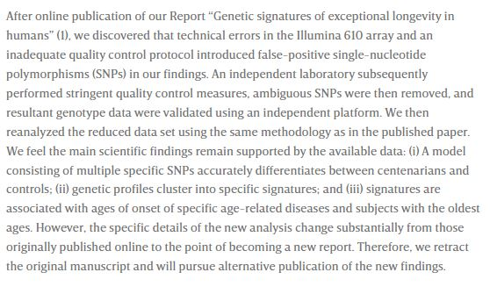
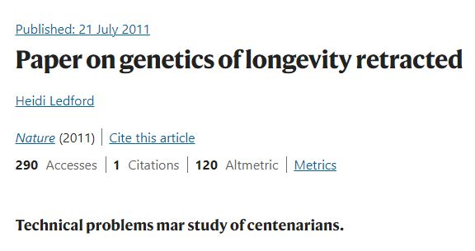
Quality control
QC prior to GWAS analysis is very important

Slide 23
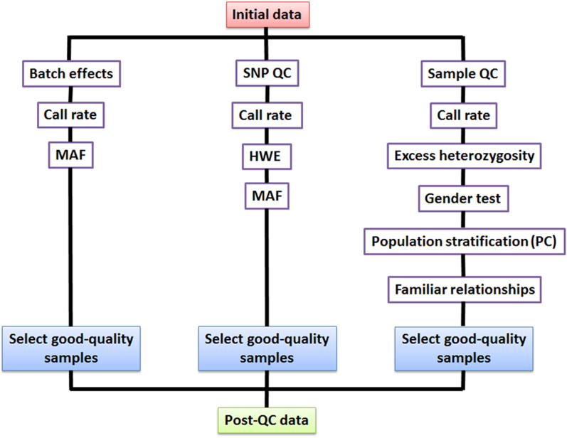
Quality control
QC done at
Individual-level or Sample-level
Marker-level or SNP-level

Slide 24
Sample-level QC
Exclude samples with low genotyping rate (possibly due to low quality DNA)
--mind <threshold>
Example: --mind 0.1 remove individuals with missing genotype rate more than 10%
Exclude samples that exhibit discrepancy between recorded sex with genotyped sex
--check-sex
Exclude samples with high heterozygosity rate
--het
Remove samples that deviate ±3 SD from sample heterozygosity
Remove samples that are related
--genome --min <threshold>
Done using pairwise identify-by-decent (IBD)
IBD = 1 => identical; 0.5 => 1st degree relatives; 0.25 => 2nd degree; 0.125 => 3rd degree
Exclude samples with genetic ancestry inconsistent with the ancestry of the population being studied
Note: Steps 3 - 5 are generally done with high quality pruned SNPs (to be discussed soon)

Slide 25
SNP-level QC
Remove SNPs with MAF < 0.05 or 0.01
--maf <threshold>
E.g: --maf 0.05
Removing missing SNPs
--geno
The SNP is missing in samples
Remove SNPs not in Hardy-Weinberg equilibrium (i.e., HWE p < 1e-6)
--het <threshold>
E.g.: --het 1e-06

Slide 26
QC
Heterozygosity:
Very high or low heterozygosity rates in individuals could be due to DNA contamination or high levels of inbreeding
Therefore, samples with extreme heterozygosity are typically removed as QC
HWE:
Poor-quality genotyping can result in heterozygotes being called as homozygotes, generating more homozygotes than expected
Setting P <10−6 as the threshold implies one SNP per million will be removed when HWE holds
Only SNPs extremely discordant with HWE should be removed as mild HWE may also be due to processes related to disease

Slide 27
SNP Pruning
Process of removing highly correlated SNPs
We do this when we want to examine heterozygosity or ancestry or create genomic principal components
Command:
plink --indep-pairwise <window> <step> <rsq> --bfile g1000_eur --make-just-fam --out g1000_eur_prunedsnps
Window: fixed number of SNPs assessed at a time
Step: Sliding window number of SNPs
Rsq or r²: squared correlations
Step 3: window = 6
Step = 3
Step 1: window = 6
Step 2: window = 6
Step = 3

Slide 28
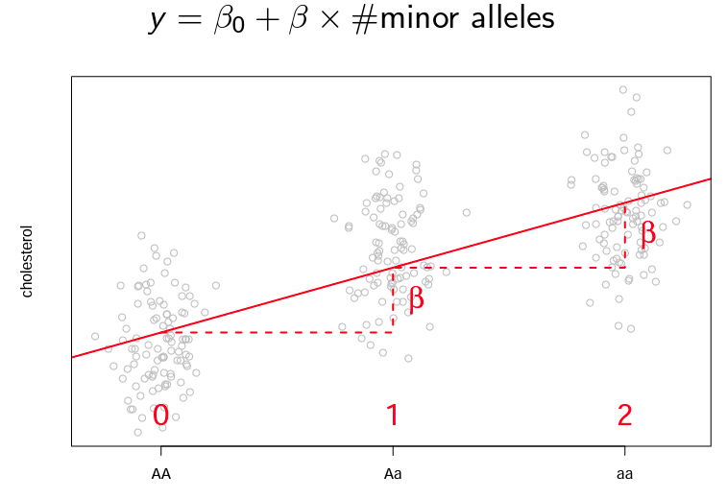
Association testing
GWAS models a single genetic marker (e.g., a SNP) as predictor in the model and the quantitative phenotype as the response along with other relevant covariates (such as age, sex, etc.) using regression
Linear regression
Conducted when the phenotype is continuous variable (height)
--linear
Logistic regression
Conducted when the phenotype is binary (case/control)
--logistic
Most GWAS conduct single SNP association testing with linear regression assuming an additive model
Linear regression of SNPs : Additive model

Slide 29
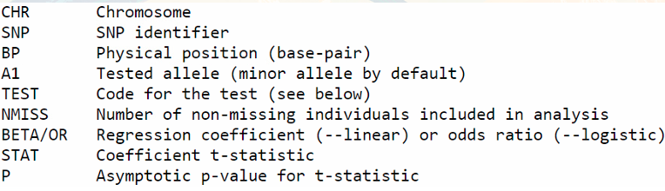
Results
PLINK association testing produces a file with the following columns

Slide 30
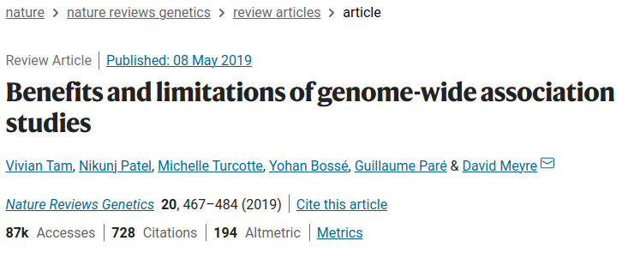
Benefits and limitations of GWAS
Benefits
Successful in identifying novel variant–trait associations
Provides insights into novel biological mechanisms
Aid in clinical translation
Provide insight into ethnic variation of complex traits
Enable study of low-frequency and rare variants
Can identify novel monogenic and oligogenic disease genes
Limitations
Penalised by multiple testing burden
Explain only a modest fraction of the missing heritability
Do not necessarily pinpoint causal variants and genes
Cannot identify all genetic determinants of complex traits
Limited clinical predictive value
Affected by population structure and cryptic-relatedness
Majority are focussed on European ancestry

Slide 31
DNA methylation

Slide 32
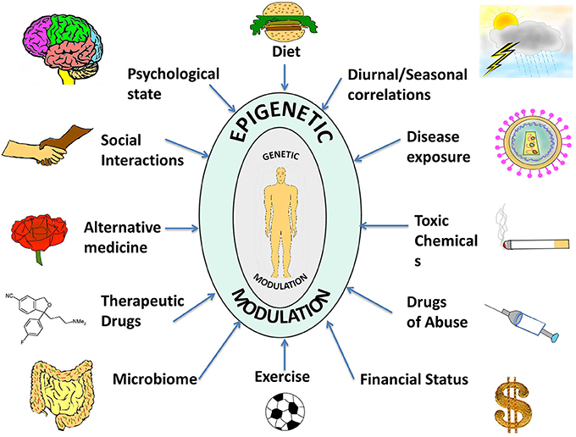
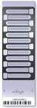
Measuring the influence of the environment on the genome
DNA methylation (Epigenetics)
Gene-expression
GACGTATCGATGCGC
M
M
DNA
RNA
Protein
Disease

Slide 33
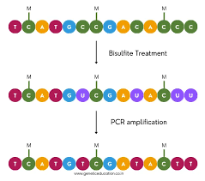

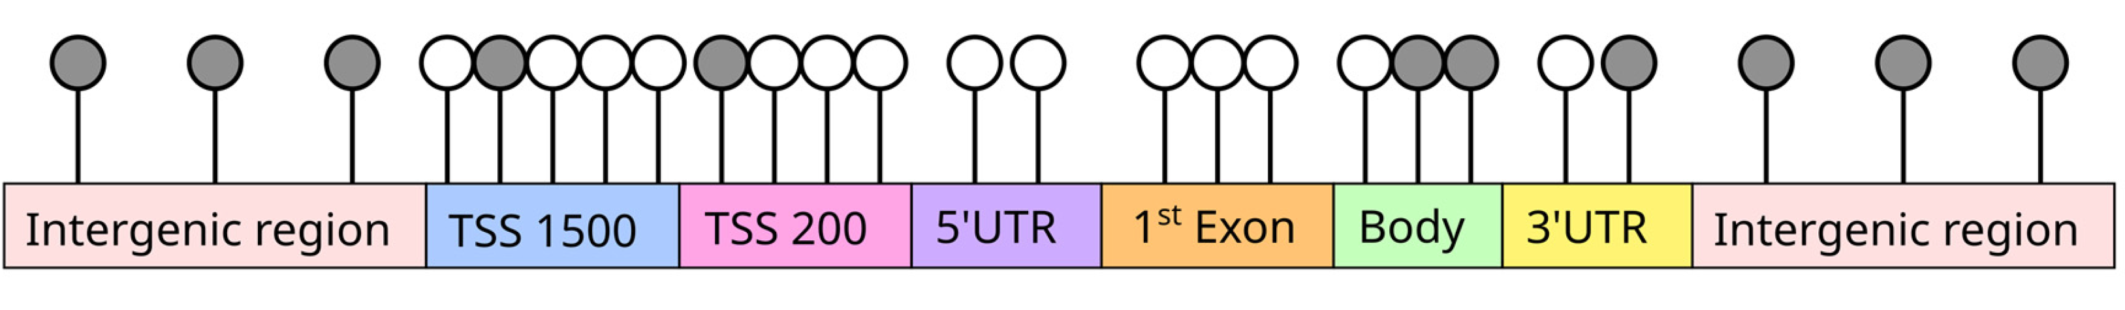
Illumina EPIC array (DNAm)
http://journal.frontiersin.org/article/10.3389/fcell.2014.00049/full

Slide 34
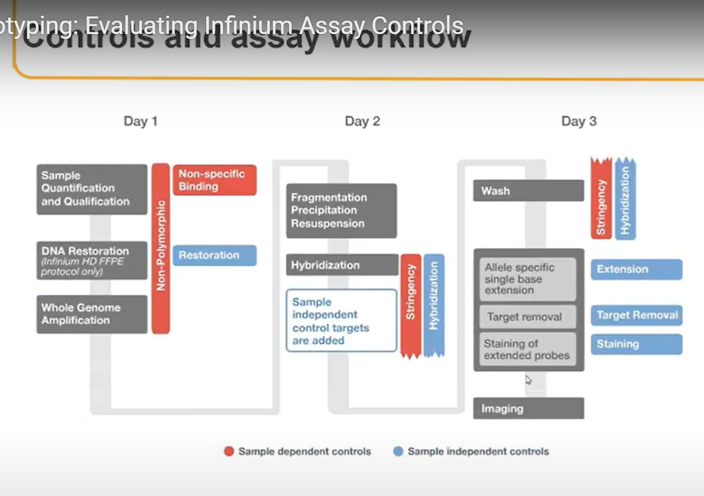
Infinium Assay Workflow
Notes:
Let’s begin with an overview of the Infinium Assay Workflow. This protocol comes from Illumina’s Infinium Methylation Assay, a widely used method for measuring DNA methylation across the genome.
The protocol consists of three days, and it includes a sequence of laboratory steps designed to prepare your DNA sample for what's called interrogation, meaning testing or reading the methylation status of specific locations in the genome using the array, on the BeadChip, which is as physical slide that contains multiple arrays.
The workflow starts with sample quantification, which means measuring the concentration and purity of DNA to ensure there’s enough, and that it’s not contaminated.
Then, if the DNA is degraded, especially those preserved in Formalin-Fixed Paraffin-Embedded (FFPE) tissue blocks we apply a DNA restoration step to repair it.
Next, we perform whole genome amplification, which is a technique used to make many copies of the entire DNA sample. This ensures there's enough material for the rest of the workflow.
The DNA is then enzymatically fragmented, so it can be more efficiently processed and hybridized.
Hybridization refers to the process where these DNA fragments bind to specific probes on the array. These probes are designed to attach to CpG sites which are spots where a cytosine nucleotide is followed by a guanine nucleotide.
The final day consists of a series of chemical reactions:
Single-base extension: one nucleotide is added at a specific location depending on whether the DNA at that CpG site is methylated or not.
Target removal clears excess reagents.
Staining adds fluorescent labels to the newly incorporated nucleotides.
And finally, imaging captures this fluorescent signal, generating raw data files known as IDAT files, which will be analyze later.
Now, a key part of this workflow is understanding the different type of controls, which are visualized here as red and blue bars on the slide:
The red bars indicate sample-dependent controls. These monitor aspects that vary depending on your actual sample whether the bisulfite conversion (a key chemical step used to distinguish methylated from unmethylated cytosines) worked well, whether the DNA amplified properly, or if there’s non-specific binding where DNA sticks to probes it shouldn't.
The blue bars indicate sample-independent controls. These use standardized DNA sequences built into every array. They help monitor technical consistency, including hybridization, stringency (how tightly the DNA binds to probes), extension fidelity (whether the right base was added), and signal intensity (how bright the fluorescence is).

Slide 35
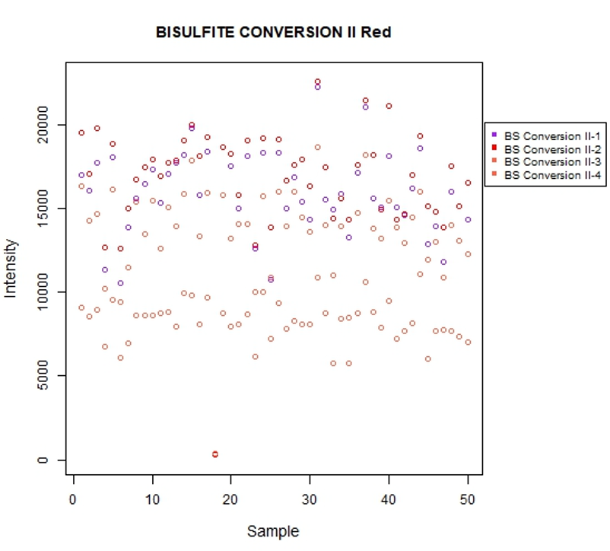
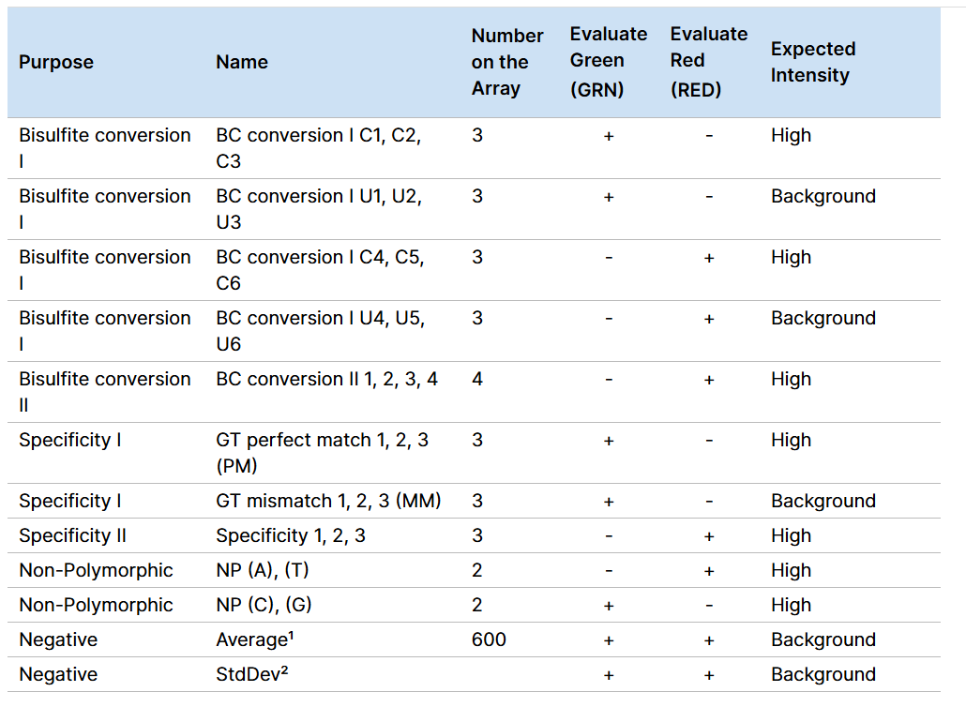
System Controls: ENmix
High Intensities
Low Intensities
Background
Infinium controls do not use specific thresholds.
To remove samples, we rely on multiple metrics.
Notes:
This slide introduces how we assess system-level quality controls using the Bioconductor package ENmix.
One of the main reasons we use ENmix is that it produces control plots similar to those generated by Illumina’s GenomeStudio software.
To help us explore this, we will focus on one specific sample-dependent control: the Bisulfite Conversion II control.
Bisulfite conversion allows us to distinguish between methylated and unmethylated cytosines by converting unmethylated cytosines into uracils. If this step is inefficient, it can lead to incorrect methylation measurements across the genome.
In the left-hand plot, each point represents the signal intensity for a single sample.
In the accompanying table, you can see that the Bisulfite Conversion II control is expected to show high intensity in the red channel. This expectation is confirmed visually in Enmix for most of the probes, however there is one sample that it is out of range.
An important point to understand is that Infinium controls are not evaluated using absolute intensity values. Instead, we interpret them based on their expected signal range across the dataset. This approach intend to consider greater flexibility and reliability when accounting for natural biological variation.
We can zoom in and visualize this more clearly in the right-hand plot:
The blue region represents high-intensity signals, which indicate successful bisulfite conversion.
The green region indicates intermediate intensities, which may require additional review.
The orange region reflects background signal, often associated with failed or suboptimal conversion.
To conclude this section:
Infinium controls do not use specific thresholds.
Sample exclusion decisions are based on multiple quality control metrics.

Slide 36
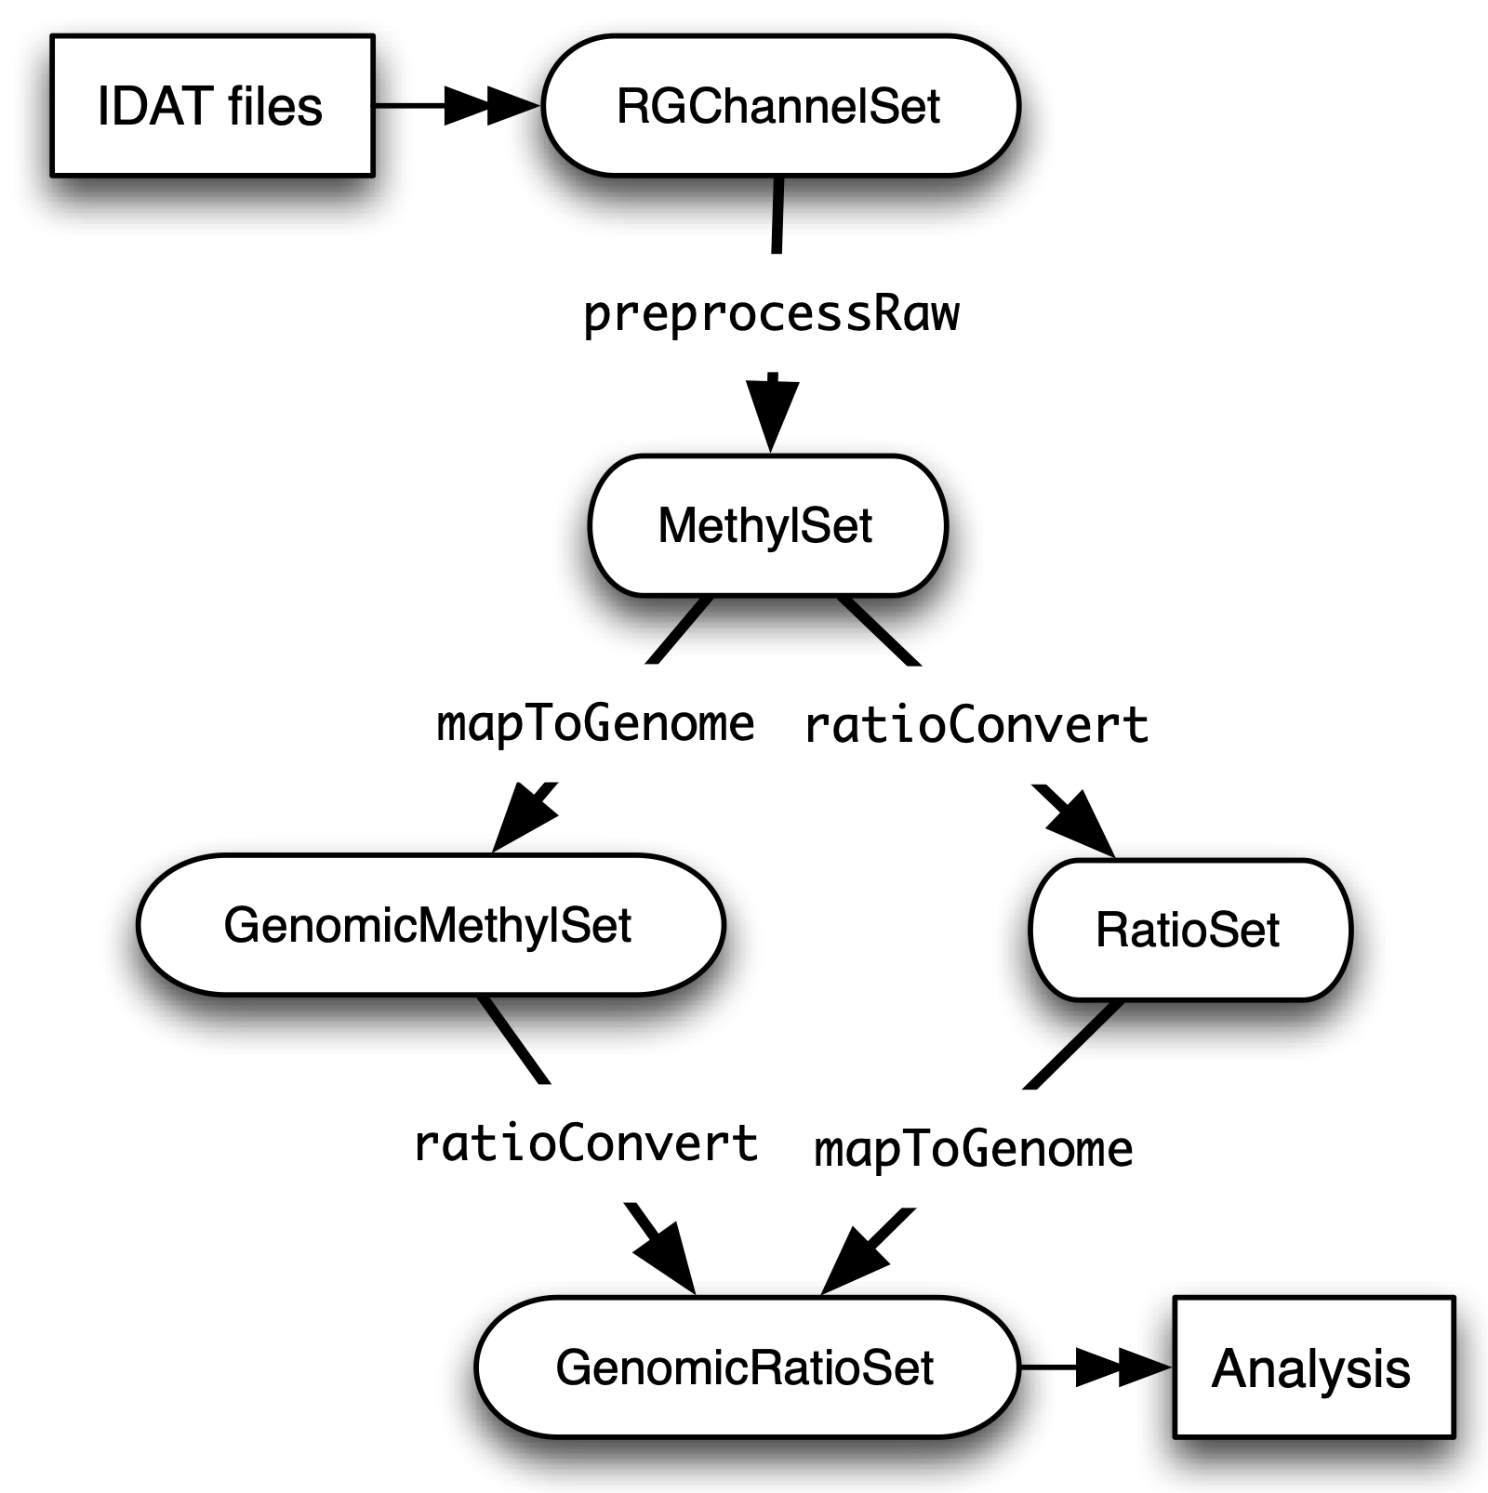
Class Structure: Minfi
Notes:
This slide provides a visual overview of the Minfi class structure, which is the foundation of many DNA methylation analyses in R.
This structure shows how raw IDAT files are progressively transformed into analysis-ready objects through a series of class conversions.
We begin at the top with the IDAT files, which contain raw fluorescence intensity data one file for the red channel and one for the green for each sample.
These are first read into an RGChannelSet object. This object holds both raw red and green signal intensities and is the starting point for all preprocessing.
From there, we apply a function such as preprocessRaw() or another normalization method. This generates a MethylSet, which contains two key matrices: methylated (M) and unmethylated (U) intensities for each CpG site. At this stage, we are still working with untransformed values.
From the MethylSet, we can proceed in two directions:
Using the mapToGenome() function, we obtain a GenomicMethylSet. This adds genomic coordinates, allowing us to relate CpG sites to genes or regions as promoters and CpG islands.
Additionally, using ratioConvert(), we generate a RatioSet, which contains Beta values (the proportion of methylation) and M-values (a logit transformation often used in statistical models). These provide more interpretable representations of methylation levels.
Finally, both GenomicMethylSet and RatioSet can be further converted into a GenomicRatioSet. This class includes both ratio-based methylation values and genomic context, making it the most comprehensive object for downstream analysis, such as differential methylation, plotting, or annotation.

Slide 37
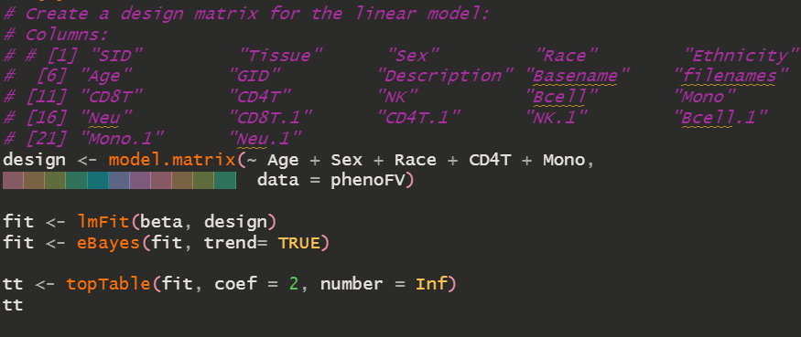
Generalized Linear Model (GLM): Limma
Methylation ∼ Age + ε
Notes:
This slide introduces the use of Generalized Linear Models (GLMs) for DNA methylation analysis, and how we apply them using the limma package in R.
In simple terms, a linear model allows us to evaluate the relationship between DNA methylation levels and one or more explanatory variables in this case, age, along with other covariates such as sex, race, and estimated cell-type proportions.
At the top, you see a shorthand model formula:
Methylation ~ Age + ε
This means we are examining how methylation levels vary as a function of age, while accounting for random error (ε).
In practice, we model this across hundreds of thousands of CpG sites using Limma, a package originally developed for gene expression analysis but widely adopted for methylation data because of its efficiency and flexibility in fitting linear models across high-dimensional datasets.
Let’s walk through the code step by step:
We first define a design matrix, which encodes all the variables we want to include in the model such as age, sex, race, and cell-type estimates.
Next, we apply the lmFit() function from limma, which fits a linear model for each CpG site using our beta matrix.
Then we apply eBayes(), which stands for empirical Bayes moderation.
Finally, we use topTable() to extract the top differentially methylated CpGs sorted by p-value for a specific coefficient in the model. In this example, coef = 2 corresponds to age, meaning we are testing the association between methylation and age while adjusting for all other covariates.

Slide 38
References
Bates, D., Mächler, M., Bolker, B., & Walker, S. (2015). Fitting Linear Mixed-Effects Models Usinglme4. Journal of Statistical Software, 67(1). https://doi.org/10.18637/jss.v067.i01
Du, P., Zhang, X., Huang, CC. et al. Comparison of Beta-value and M-value methods for quantifying methylation levels by microarray analysis. BMC Bioinformatics 11, 587 (2010). https://doi.org/10.1186/1471-2105-11-587
Fortin, JP., Labbe, A., Lemire, M. et al. Functional normalisation of 450k methylation array data improves replication in large cancer studies. Genome Biol 15, 503 (2014). https://doi.org/10.1186/s13059-014-0503-2
Hansen, K. D., & Fortin, J.-P. (2025). The minfi User’s Guide. In https://bioconductor.org/packages/devel/bioc/vignettes/minfi/inst/doc/minfi.html
Heiss, J. (2013). Recommended Work Flow. In https://hhhh5.github.io/ewastools/articles/exemplary_ewas.htmlHorvath, S. (2013). DNA methylation age of human tissues and cell types. Genome Biol, 14(10), R115. https://doi.org/10.1186/gb-2013-14-10-r115
Koestler, D.C., Jones, M.J., Usset, J. et al. Improving cell mixture deconvolution by identifying optimal DNA methylation libraries (IDOL). BMC Bioinformatics 17, 120 (2016). https://doi.org/10.1186/s12859-016-0943-7

Slide 39
References
Maksimovic, J., Phipson, B., & Oshlack, A. (2017). A cross-package Bioconductor workflow for analysing methylation array data. F1000Research, 5. https://f1000research.com/articles/5-1281
Marschner, I. C. (2011). glm2: Fitting Generalized Linear Models with Convergence Problems. R Journal, 3(2), 12-15. https://journal.r-project.org/archive/2011/RJ-2011-012/RJ-2011-012.pdf9. Pelegri , D., & Gonzalez, J. R. (2015). Chronological and gestational DNAm age estimation using different methylation-based clocks. In https://bioconductor.org/packages/release/bioc/vignettes/methylclock/inst/doc/methylclock.html
Peters TJ, Meyer B, Ryan L, Achinger-Kawecka J, Song J, Campbell EM, Qu W, Nair S, Loi-Luu P, Stricker P, Lim E, Stirzaker C, Clark SJ, Pidsley R. Characterisation and reproducibility of the HumanMethylationEPIC v2.0 BeadChip for DNA methylation profiling. BMC Genomics. 2024 Mar 6;25(1):251. doi: 10.1186/s12864-024-10027-5. PMID: 38448820; PMCID: PMC10916044.
Touleimat, N., & Tost, J. (2012). Complete Pipeline for Infinium® Human Methylation 450K BeadChip Data Processing Using Subset Quantile Normalisation for Accurate DNA Methylation Estimation. Epigenomics, 4(3), 325–341. https://doi.org/10.2217/epi.12.21
Wang Y, Hannon E, Grant OA, Gorrie-Stone TJ, Kumari M, Mill J, Zhai X, McDonald-Maier KD, Schalkwyk LC. DNA methylation-based sex classifier to predict sex and identify sex chromosome aneuploidy. BMC Genomics. 2021 Jun 28;22(1):484. doi: 10.1186/s12864-021-07675-2. PMID: 34182928; PMCID: PMC8240370.

